Slide 1



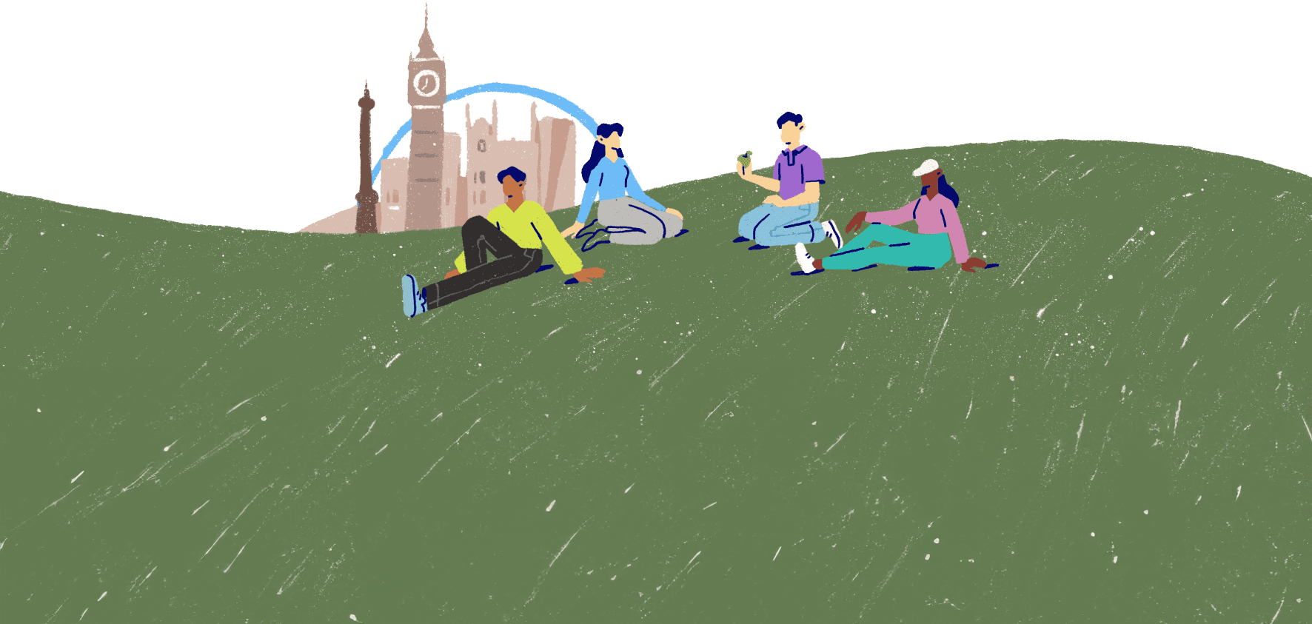
Mental health challenges
Lesson 3

Slide 2


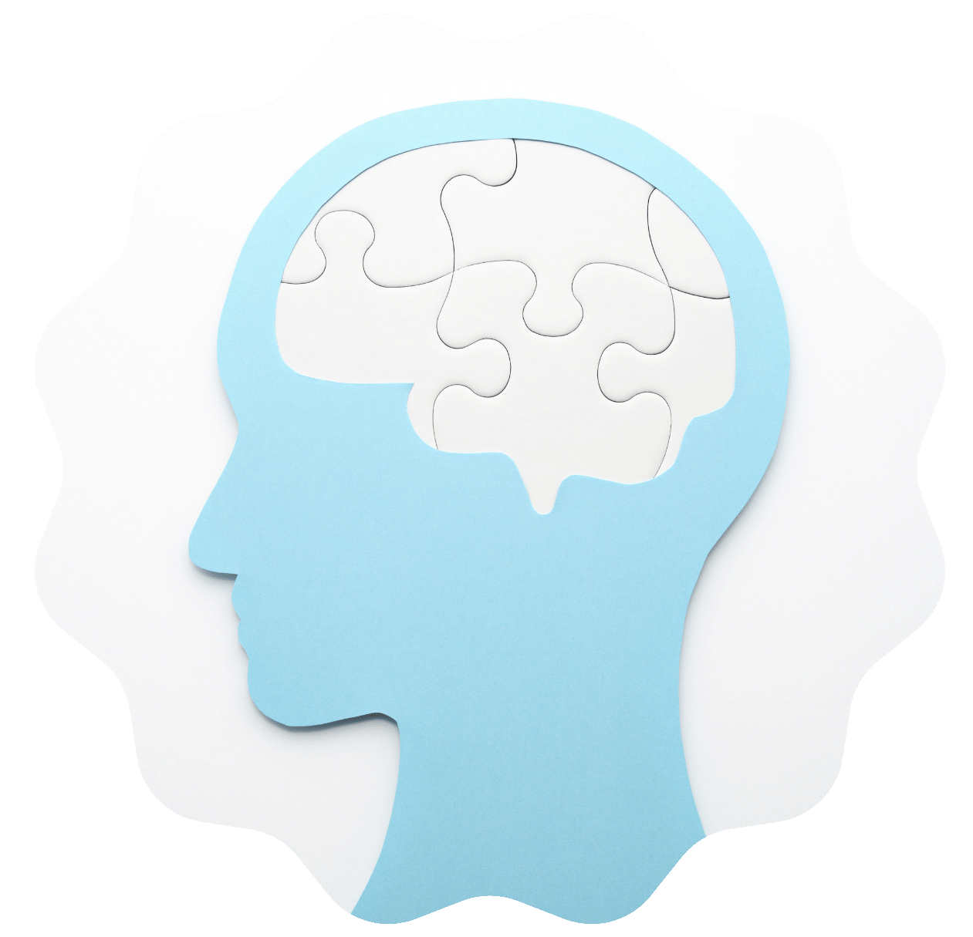
Health problems
If you were asked to name health concerns, conditions and illnesses you've heard of, it's likely you'd think of conditions that primarily affect a person's physical health.
But can you name any mental health conditions?
Photo from Canva

Slide 3
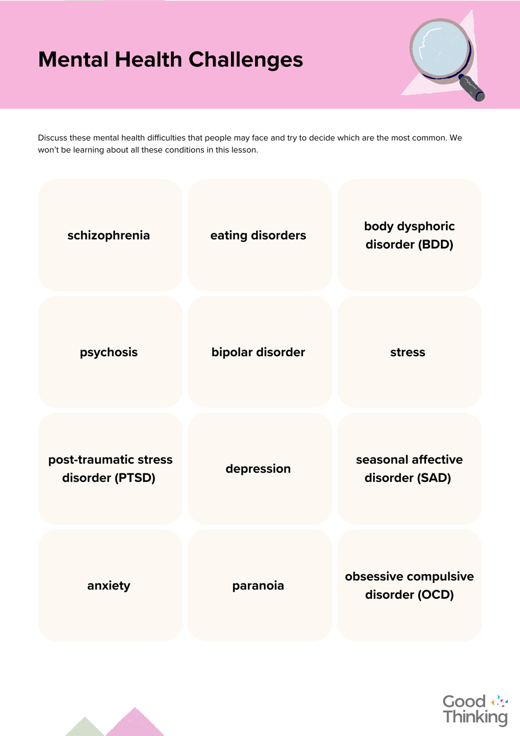
Mental ill health
Just as people can suffer from physical ill health, they can suffer from mental ill health.
The challenges people face with their mental health may be referred to as problems, issues, difficulties, challenges, conditions, illnesses or disorders.
Some mental health challenges are more common than others. Look at the mental health challenges in your groups and try to decide which are the most common.

Slide 4
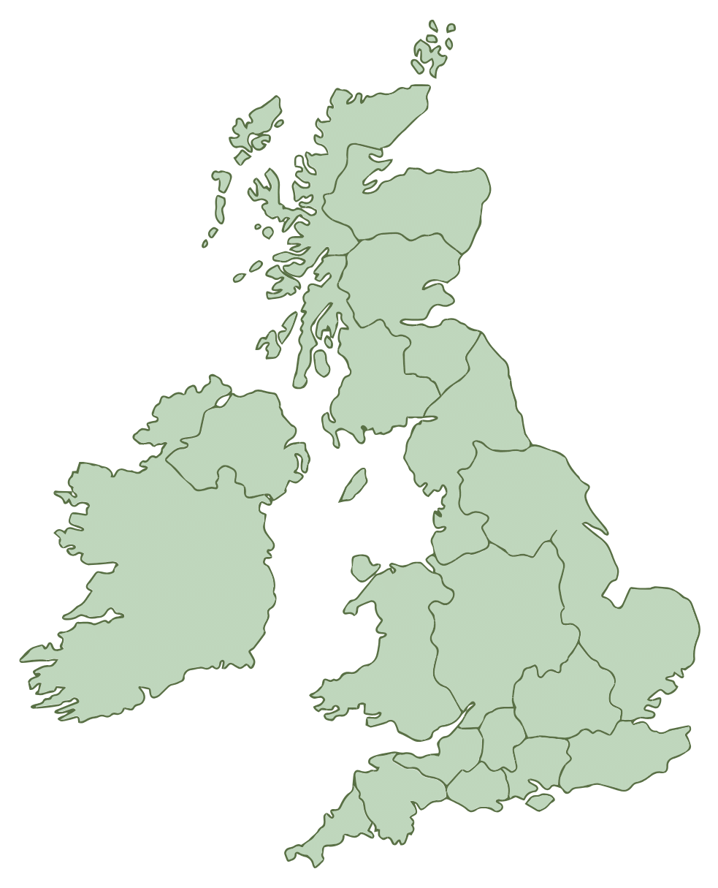
Common types of mental ill health
Research shows that some types of mental health conditions are common...
According to a report published by NHS England in 2023, ‘One in five children and young people in England, aged between eight to 25 have a probable mental disorder’. ​
During 2023, mental health services in England received 5 million referrals.
Anxiety and low mood are the most common mental health challenges, along with stress.

Slide 5
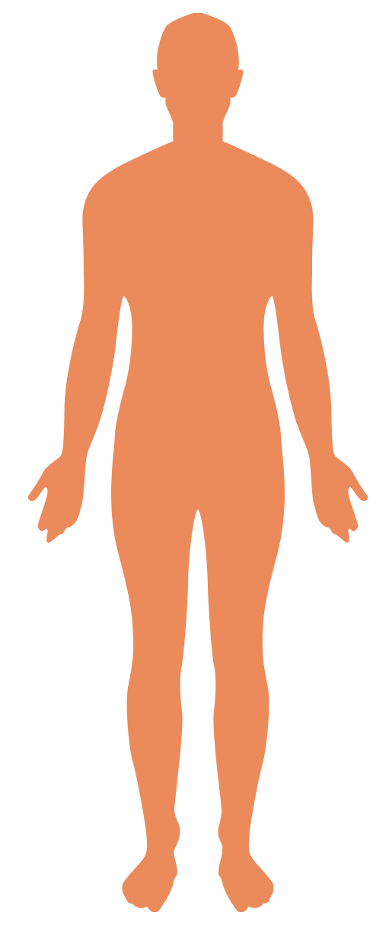


Mental health challenges and physical symptoms
Our mental and physical health and wellbeing are intrinsically linked.
Maintaining good physical health can positively impact our mental wellbeing.
Equally, mental health difficulties often impact a person physically. In fact, it can be the physical symptoms that cause a person to notice that they are experiencing difficulties with their mental health.

Slide 6
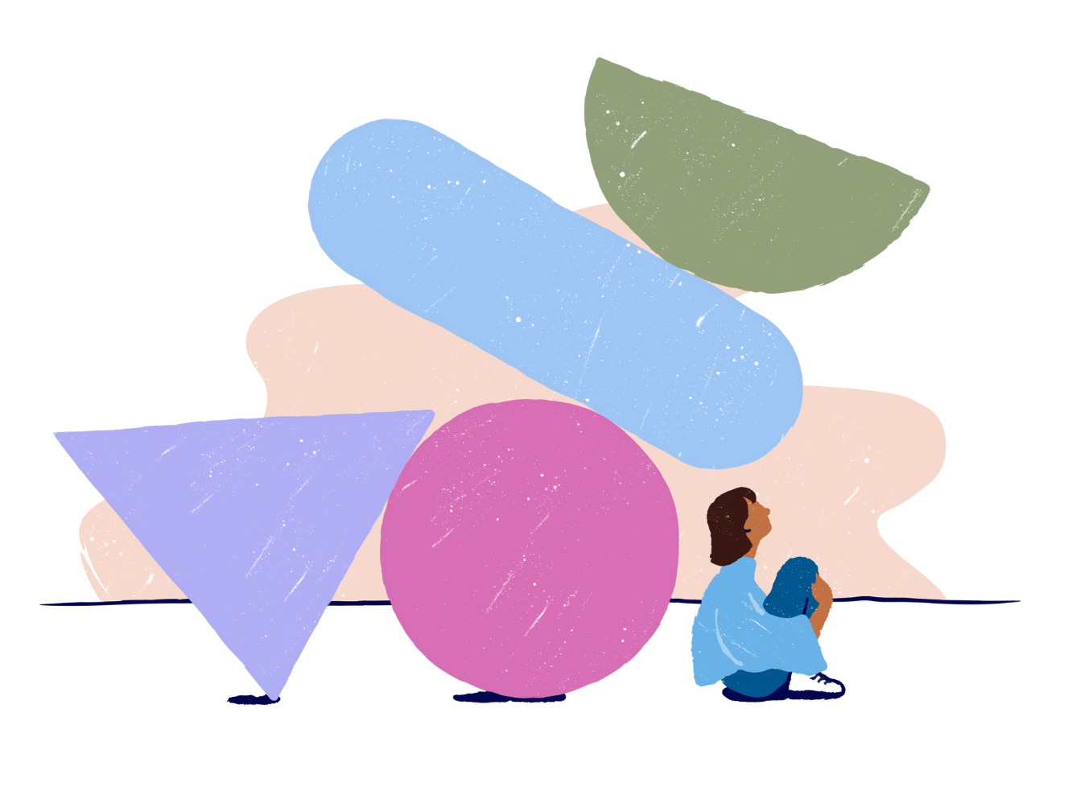
Anxiety
The NHS describes anxiety as "a feeling of unease, such as worry or fear, that can be mild or severe".
When might a person experience feelings of anxiety?
Think about how anxiety might affect a person. You can use your own experiences of anxiety if you wish to. Make some notes on your Common Mental Health Conditions sheet.

Slide 7


Low mood
The NHS lists the symptoms of low mood and sadness as:
feeling sad, anxious or panicky
feeling more tired than usual or difficulty sleeping
feeling angry or frustrated
experiencing low confidence or self-esteem
Persistent low mood can lead to depression. The NHS states that "Depression is not a sign of weakness or something you can "snap out of" by "pulling yourself together"."
Picture to represent low mood
Why do you think they feel it is important to mention this?
Jot down ways in which low mood might affect a person.
Photo from Canva

Slide 8

Stress
Photo from Canva
The NHS describes stress as "the body's reaction to feeling threatened or under pressure".
Too much stress can negatively impact our mood, our body and our relationships.
People experiencing long-term or severe stress can experience something called 'burnout'. What do you think this is?

Slide 9
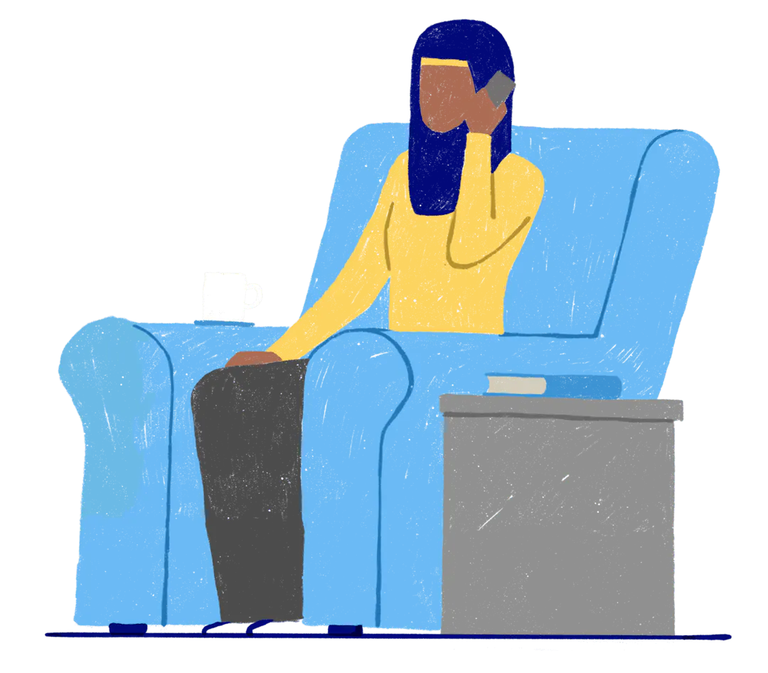

Treating mental health conditions
There are many treatment options to help people who are experiencing mental ill health, whether common or complex, mild or severe.
Getting advice from health professionals about the best treatment is important, as different things work for different people at different times.

Slide 10

"This feeling will pass. The fear is real, but the danger is not."
Cammie McGovern
Photo by Clovis Wood on Unsplash

Slide 11


